Slide 1
Project 2 - SQS
Zack Arnett
Madison Bartlett
Hunter Bowman
Parker Householder
Notes:
15 minute presentation, not to sell or illustrate how to use it

Slide 2

Our Customer
Who are they
Quality Assurance Specialists
What do they do
Run scripts to find bugs in customer’s websites
What did they want
Enhanced Training Web Application
Additional Features
Working “defects” within the site
Notes:
Madison

Slide 3



Getting Started
Group Communication and Organization
Trello
Slack
Atom
Provided from the previous group
XAMPP - Web server solution stack
Languages: php, javascript, and HTML
Purchased live domain: sqstraining.tech
Notes:
Parker
What was given to us, how we got everything set up
What we used as a group
-Trello
-Slack
-Atom
-Buying domain/having a live site
-Database

Slide 4


Problems We Faced
Dump files incorrectly formated
Poorly structured database
Group meetings
Meeting onsite with customer
Project time frame
Notes:
Parker
Customer could only meet at specific times and we all had conflicting class schedules

Slide 5

Product Evolution
Customer Requests
Improved functionality
Updated graphic design
Notes:
Madison
Does the project match what the customer initially wanted, how did it evolve
Pretty much, we just went off their list of requests and completed all of the main ones along with some additional features
Discuss your initial assumptions about the project compared to what you know now

Slide 6
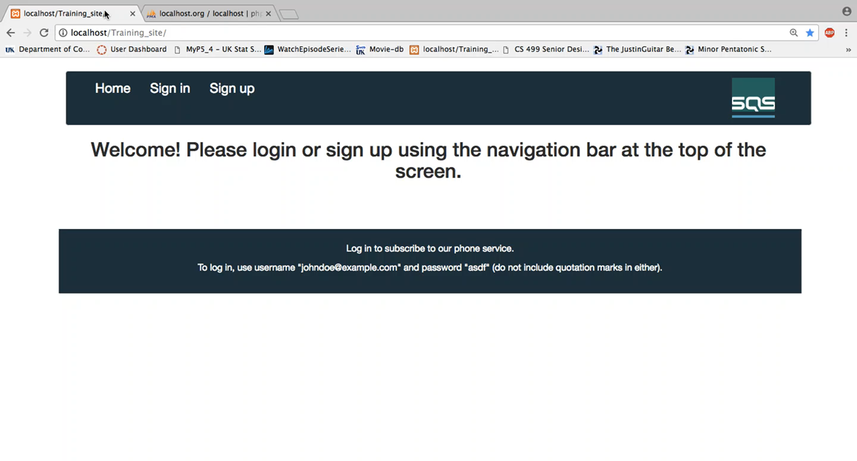
Previous Group’s Home Page
Notes:
Madison
Skip/delete this slide?

Slide 7
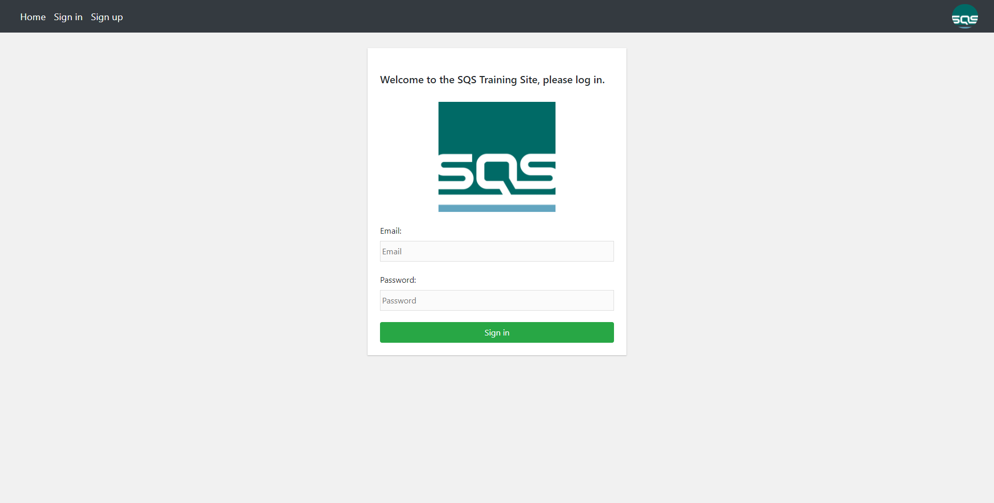
Our Login Page
Notes:
Madison
Skip/delete this slide?

Slide 8
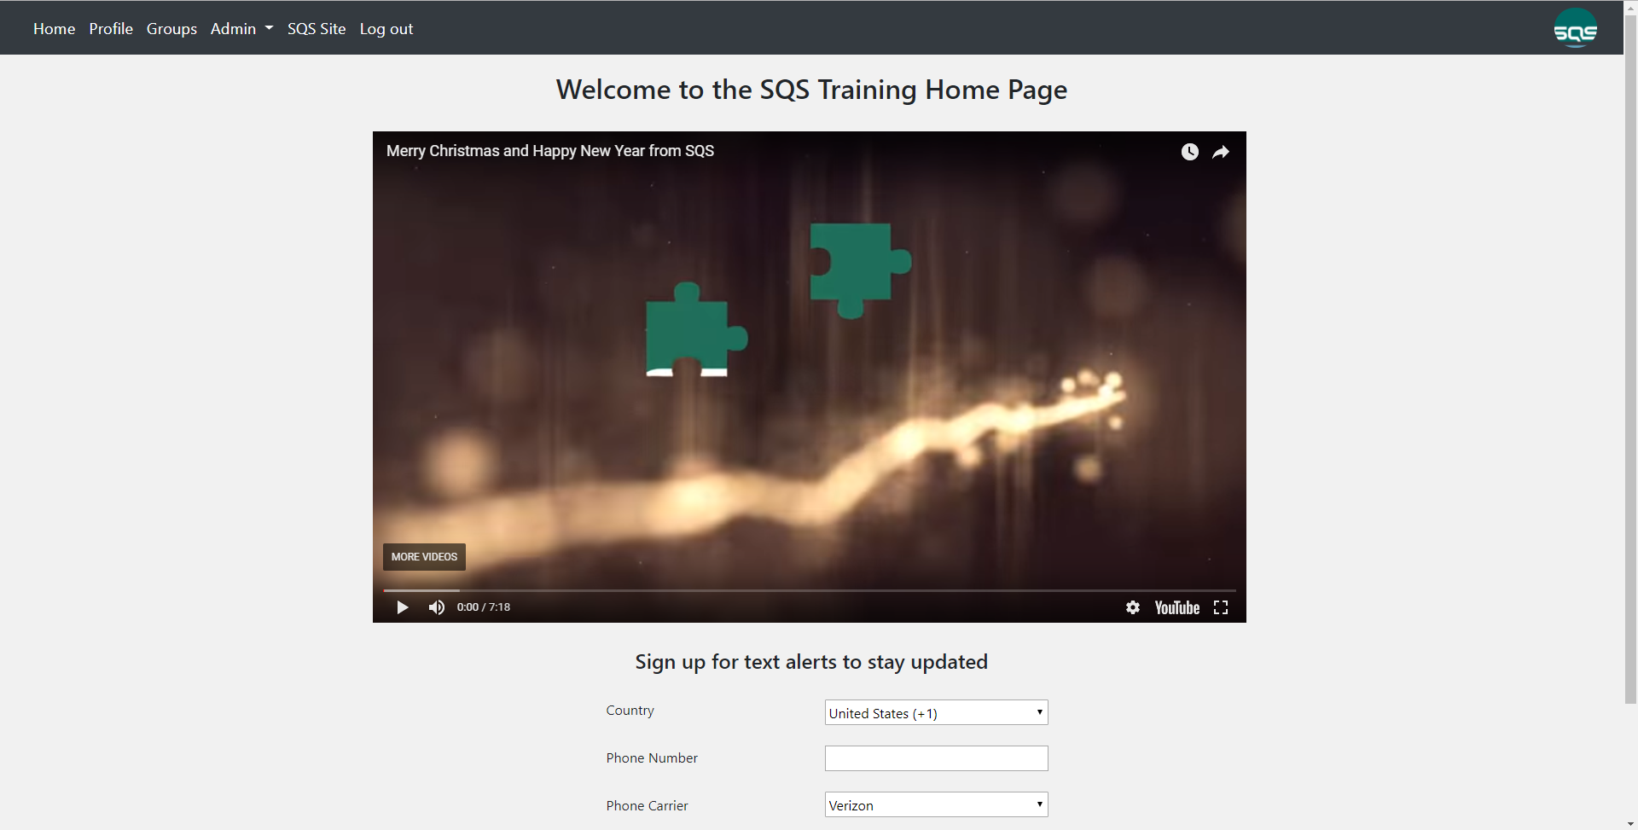
Notes:
Madison

Slide 9
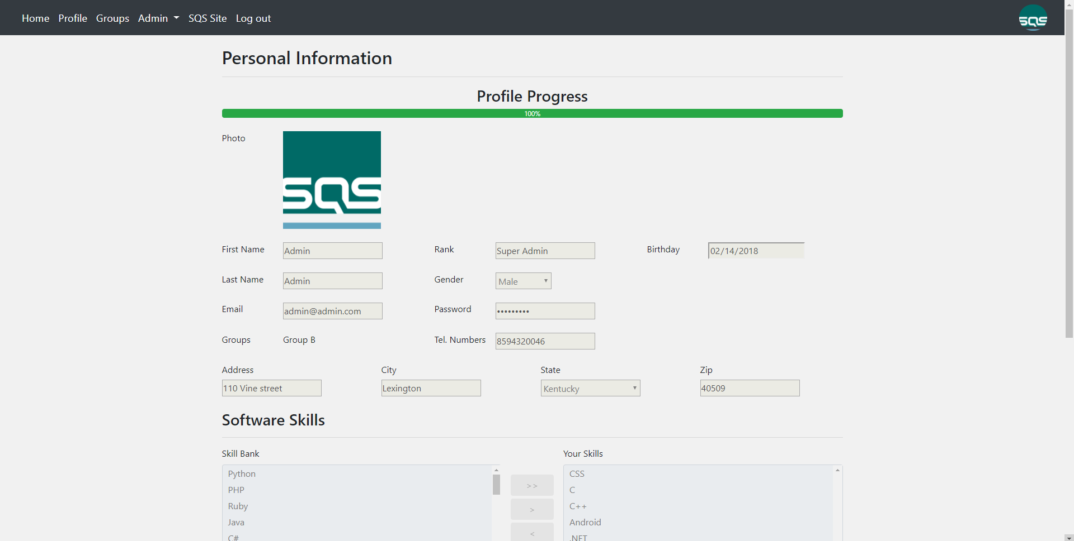
Notes:
Madison

Slide 10
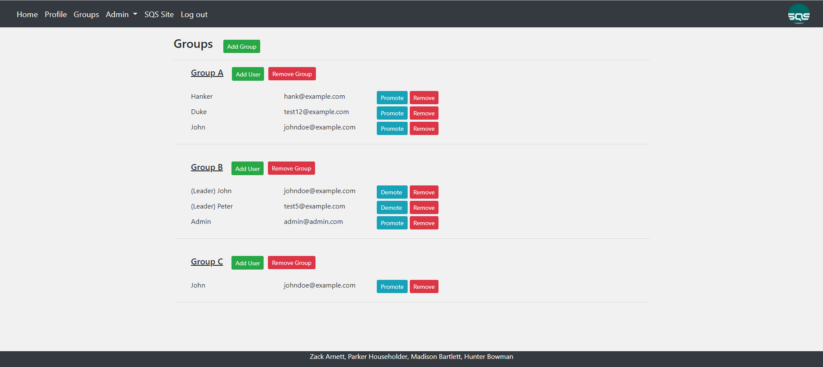
Notes:
Zack

Slide 11
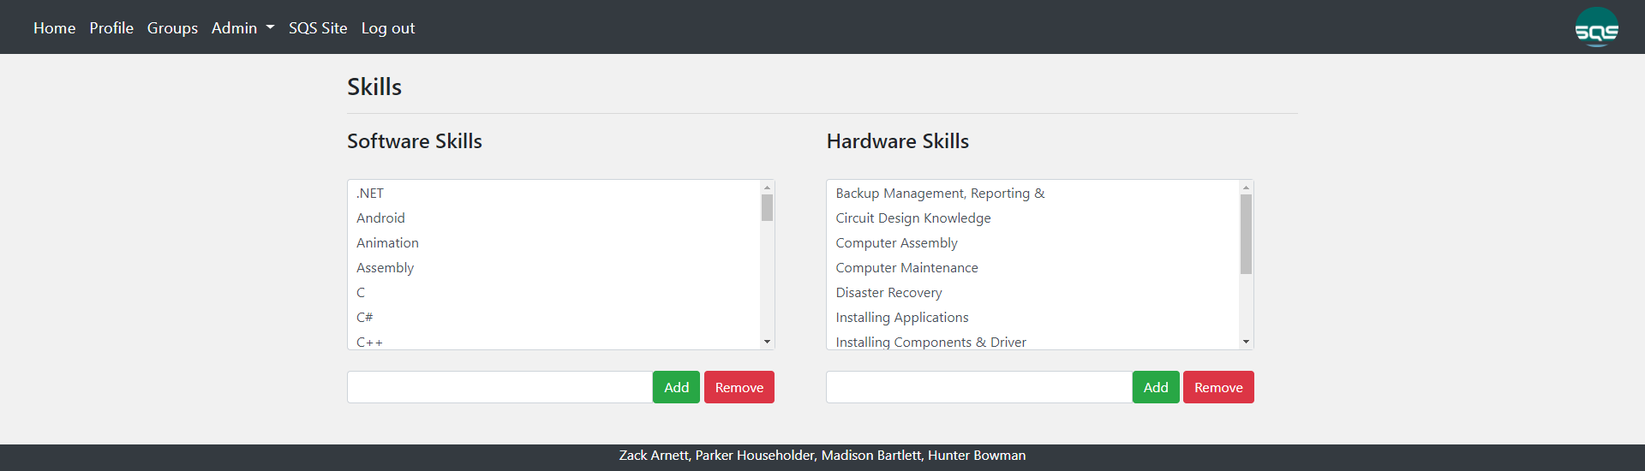
Notes:
Zack

Slide 12
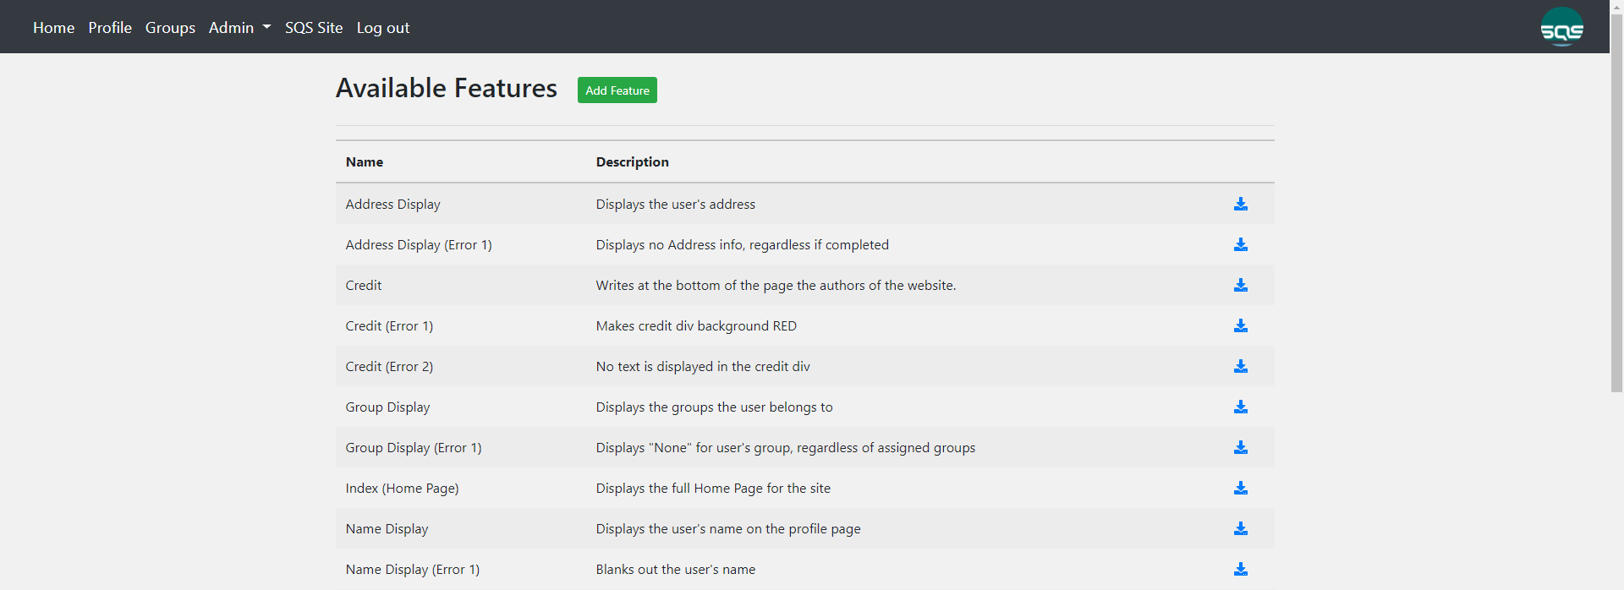
Notes:
Parker

Slide 13
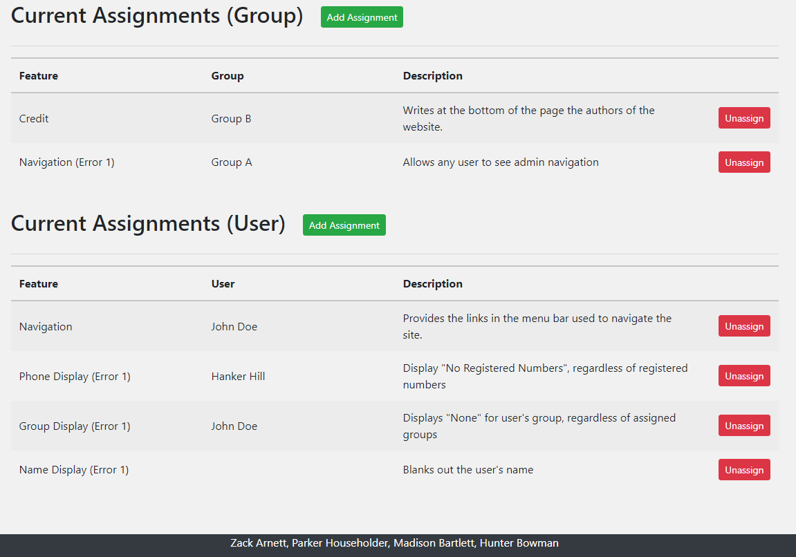
Notes:
Parker

Slide 14

Time for a Quick Demo
Notes:
Error Example

Slide 15

Changes Throughout
Site actually works
Admin skills page
Error functionality
Any user can only have 1 connection at a time
Character limits
Groups
Notes:
Zack
Changes requested by the customer, or changes to specifications due to implementation
Customer had a long list of requests and we completed a ton of them. Some main points
Concurrent users: more than one person can be logged in at once
Admin skills page
Add video
Error functionality
Any user can only have 1 connection at a time
Character limits

Slide 16

In the Future
Expand features/errors to test
Password reset option
Search group for specific members
New pages/More content to current pages
New functionality
Notes:
Hunter
Future enhancements
Overall we made a product that worked and met all the minimum specifications the customer wanted. I’m sure once they start using the site they will think of new features and errors they would like. We created a strong backbone that can take this project in many different directions for future groups to work on.
Expand features/errors is not us testing the site more, it’s the main thing the customer will use the site for
Examples include a password reset option and searching groups for specific members
More pages and content could be added
New functionality could be added to better help train their employees
Overall, our product works and meets the minimum specifications that our customer wanted. But, this project is by no means finished. We created a very strong backbone for future groups to implement new pages and new functionalities, such as an option to reset the users password and a search function. We also have many more ideas on our trello board that we will be giving to the customer.

Slide 17

What We Learned
Working as a team Client management
Notes:
Hunter
Discuss lessons learned while doing the project
Working as a team
Client management
Open discussion about requests
Communication on what they liked/disliked
Added features
Anything missing?
So, besides our product we had two fundamental challenges that came to light when working on this project. One being how to work as a big team on a large project. There are many different elements that go into a bigger group project than what we have encountered before. We had to organize ourselves and communicate far better than we might have done in past projects. Another challenge we had to face was working with a client throughout the project. To better understand the project we held an open discussion about the project at the beginning of the semester, but we also kept in contact with the customer throughout the process to know we were on the right track and to find out what they liked or disliked about what we had done so far. We also wanted to find out any other features they wanted implemented so that we could deliver the best product we could by the deadline.

Slide 18

Questions
Notes:
Hunter

